Slide 1

Chapter 2: Setup working environment

Slide 2
Overview
In this chapter, we will be familiar with tools that will be used during learning this course. And, setup working environment for next chapters

Slide 3
RVM
“RVM is a command-line tool which allows you to easily install, manage, and work with multiple ruby environments from interpreters to sets of gems.”
        https://rvm.io/

Slide 4
Install & setup
Install
\curl -sSL https://get.rvm.io | bash -s stable
For more details:
source ~/.rvm/scripts/rvm
echo "source ~/.rvm/scripts/rvm" >> ~/.bashrc
rvm install 2.1.2
rvm use 2.1.2 --default
ruby -v
echo "gem: --no-ri --no-rdoc" > ~/.gemrc
Reference article

Slide 5
LAB 1
Install RVM & setup for your usage

Slide 6
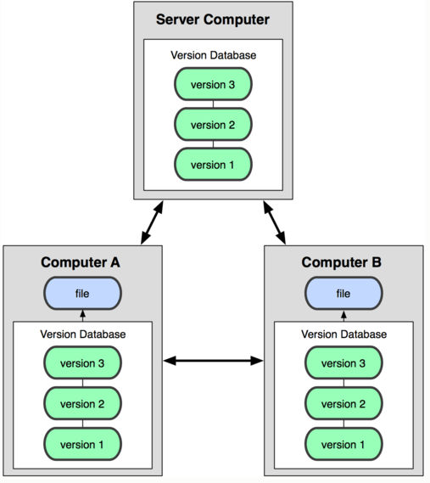
Git
“Git /ɡɪt/ is a distributed revision control and source code management (SCM) system with an emphasis on speed, data integrity, and support for distributed, non-linear workflows.Git was initially designed and developed by Linus Torvalds for Linux kernel development in 2005, and has since become the most widely adopted version control system for software development.”
^{Wiki source}

Slide 7
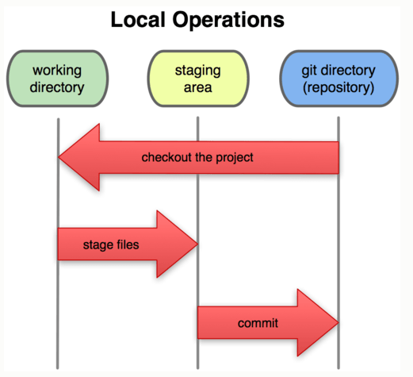
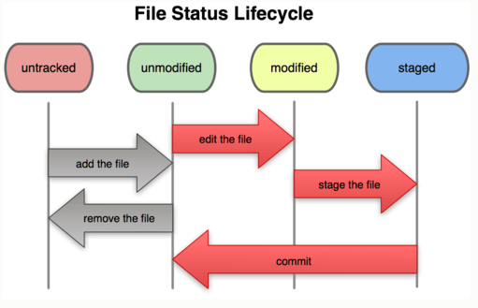
Git
Pingo keeps all example codes at
https://github.com/pingovn

Slide 8
Setup git & github
Git was installed already
Please follow steps in
  https://help.github.com/articles/set-up-git
    Set Up Git
    Create A Repository
    Fork A Repository
    Be Social with Github
Vietnamese book

Slide 9
Git basic commands
 | Example | Description
Config | git config user.name | config name
 | git config user.email | config email
Init | git config init | init a empty repo
Add & remove files to repo | git add [-r] <<file>> | add file(s) to staging area
 | git rm <<file>> | remove a file from repo
 | git mv <<old name>> <<new name>> | change file name in repo
Commit | git commit –m “message” | create a commit with message
 | git commit --amend | change last commit
Clone | git clone <<repo>> | “copy” from remote to local
Status | git status | view which files are modified in local
 | git diff [file]
Log | git log [file]
 | git show [file]

Slide 10
Git commands (cont)
 | Example | Description
Branch | git branch [-a] | list up all branch
 | git checkout <<branch name>> | change working area to new branch
 | git checkout –b <<new branch>> | create a new branch
Remote | git fetch [remote-name] | fetch data from remote to local. Default remote-name should be “origin”
 | git push [remote-name] master | push local change to remote
Tag | git tag –v <<version>> Ex: git tag –v v1.5 | create a version. “1” is version, “5” is revision. Version is “big” change, revision is “minor” change
Alias | git config --global alias.co checkout | alias “co” as checkout
File | Description
~/.gitconfig | Global config (with option –global)
.gitconfig | Local config (impact to each repo)
.gitignore | Ignored files. The changing of these files will not be shown in “git status” & “git commit”,…

Slide 11
LAB 2
Create your account on Github
Create your repo
Clone Github’s repo to local

Slide 12
Text editor
Please select your favorite editor. In this course, we will use Sublime Text as our main editor. Sublime text website.
SublimeText was installed already.

Slide 13
LAB 3
Create some data for your repo
  Create a README file (by SublimeText)
  Register these scripts to repo (by “git add”)
Push data to your repo (by “git push”)

Slide 14
Free tools for collaboration
Collaboration tools:
  Code version & issue tracker: Github
  Document: https://drive.google.com
  TV conf: Google handout
  Task assignment: https://trello.com
  Skype & Slack
    Skype: http://www.skype.com/en
    Slack: https://slack.com
We will have chance to use these tools in teamwork exercise !

Slide 15
Linux
Many Rails company use Linux. Mac & Linux are popular OSs for Rails developers.
Learning Linux commands will be helpful (will be your strong point when getting job ☺). Be familiar with Linux need time, please be patient. If you are familiar with Linux, you might not want to work with Windows ☺ !!!

Slide 16
Linux popular commands
 | Example | Description
grep | grep “text” * | Search “text”. “*” means all files
find | find –name “filena*” | Find a file or directory
diff | diff <file1> <file2> | Show different between <file1> and <file2>
cd | cd ~ | Change directory. “~” means your home directory
ls | cd ~ ls | List all files/directories
pwd | pwd | Show current directory
rm | rm [-r] <file> | Remove file/directory(-r)
cp | cp <filea> <folder/new-name> | Copy a file to a folder (might rename the file if “new-name” is specified
mv | mv <oldname> <newname> | Rename a file, or move it to another
cat | cat <file1> <file2>… | Show content of the file
mkdir | mkdir ~/test_repo | Create directory

Slide 17
Linux popular commands
 | Example | Description
chmod | chmod 755 <file> | Change mode of the file. 755 means 7(rwx) for owner, 5(r-x) for group, and 5(r-x) for others. A Ruby script needs to have “x” permission to get run
man | man chmod | Show manual of a command
touch | touch <file> | Create a EMPTY file

Slide 18
LAB 4
Open terminal
Practice every single command in previous tables
Please ASK if any UNCLEAR !!!
We really want to help. The unique issue is that we don’t know why is YOUR unclear ☹

Slide 19
Summary
Congratulation, you have learned
  Popular collaboration tools nowsaday
  Install & setup RVM
  Install & setup GIT
  Create your account in Github & push very first data to the world ☺
  Be introduced to popular Linux commands. Linux has a lot of commands that we will never know. So, it needs your time to practice.

